Slide 1
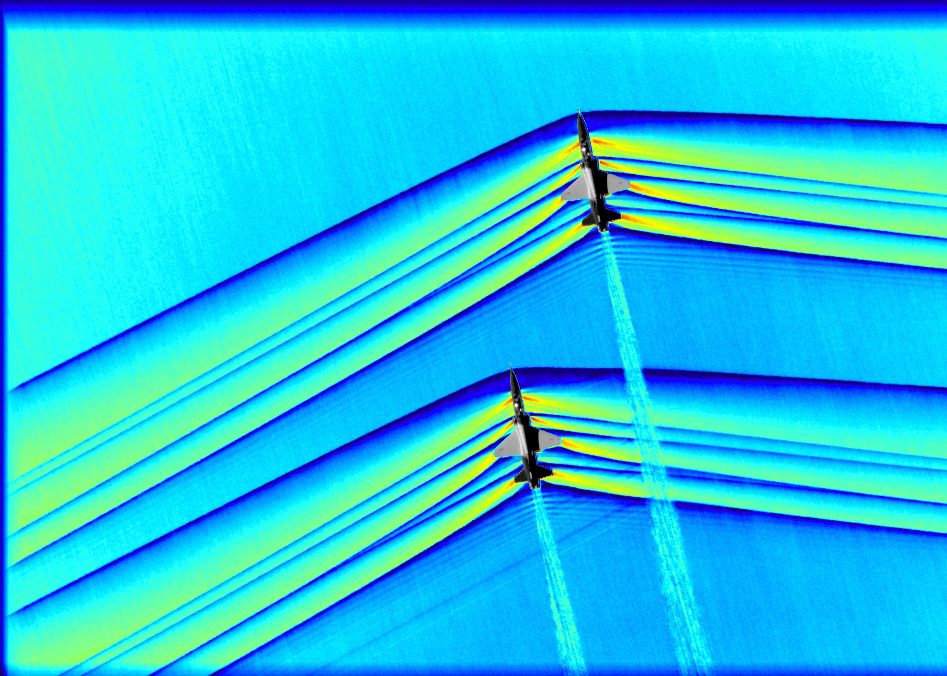
PHYS 8750 Numerical Fluid Dynamics
Fall, 2020
Nasa – Armstrong flight research center

Slide 2
PHYS 8750
Outline
Stationary Planetary Wave Model
Governing equations
Numerical schemes
Lower boundary condition and mean winds
Modeling results
Role of gravity waves for MLT SPWs
Traveling Planetary Wave Model
Governing equations
Initial condition
Mean wind and instability
Modeling results

Slide 3
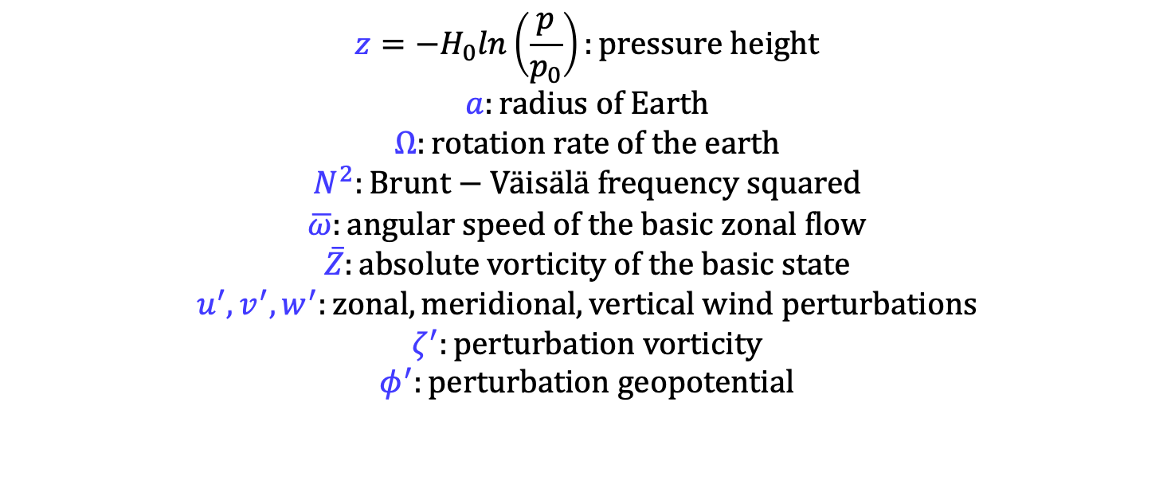
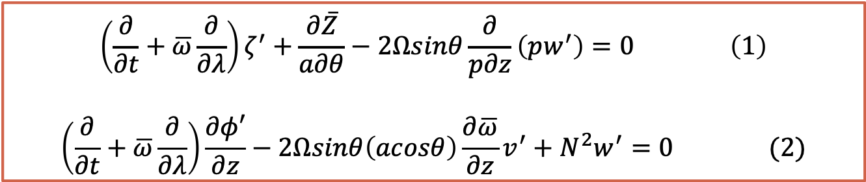
Governing Equations
The vorticity and thermodynamic equations are:
$$\left(\frac{∂}{∂t}+\overline{ω}\frac{∂}{∂λ}\right)ζ^{′}+\frac{∂\overline{Z}}{a∂θ}−2Ωsinθ\frac{∂}{p∂z}\left(pw^{′}\right)=0 \left(1\right)$$
$$\left(\frac{∂}{∂t}+\overline{ω}\frac{∂}{∂λ}\right)\frac{∂φ′}{∂z}−2Ωsinθ\left(acosθ\right)\frac{∂\overline{ω}}{∂z}v^{′}+N^{2}w^{′}=0 (2)$$
$$z=−H_{0}ln\left(\frac{p}{p_{0}}\right):pressure height$$
$$a:radius of Earth$$
$$Ω:rotation rate of the earth$$
$$N^{2}:Brunt−Väisälä frequency squared$$
$$\overline{ω}:angular speed of the basic zonal flow$$
$$\overline{Z}:absolute vorticity of the basic state$$
$$u^{′},v^{′},w^{′}:zonal, meridional, vertical wind perturbations$$
$$ζ^{′}:perturbation vorticity$$
$$φ^{′}:perturbation geopotential$$
No external Forcing

Slide 4
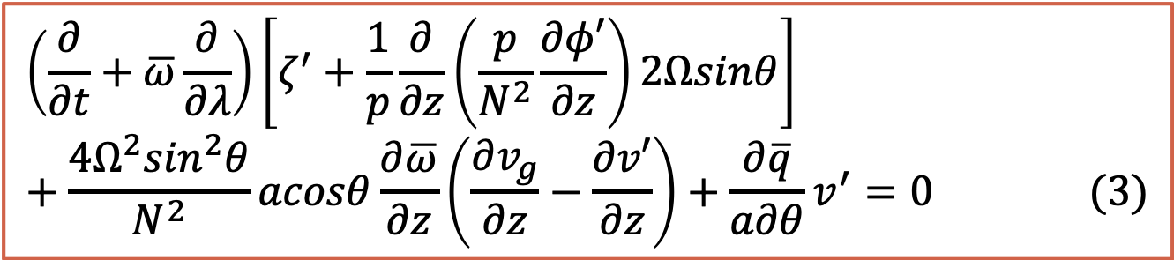
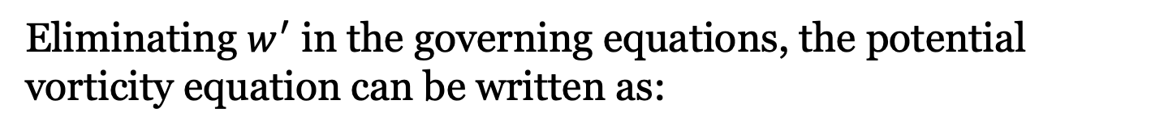
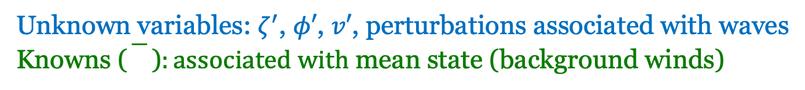
Eliminating $w^{′}$ in the governing equations, the potential vorticity equation can be written as:
$$\left(\frac{∂}{∂t}+\overline{ω}\frac{∂}{∂λ}\right)\left[ζ^{′}+\frac{1}{p}\frac{∂}{∂z}\left(\frac{p}{N^{2}}\frac{∂φ′}{∂z}\right)2Ωsinθ\right]+\frac{4Ω^{2}\sin^{2}θ}{N^{2}}acosθ\frac{∂\overline{ω}}{∂z}\left(\frac{∂v_{g}}{∂z}−\frac{∂v′}{∂z}\right)+\frac{∂\overline{q}}{a∂θ}v^{′}=0 (3)$$
Unknown variables: $ζ^{′}$, $φ′$, $v′$, perturbations associated with waves
Knowns ()$:associated with$ mean state (background winds)
Quasi-geostrophic (QG) model
(often used for large-scale wave dynamics)
Assume geostrophic wind balance
Coriolis force = pressure gradient force

Slide 5
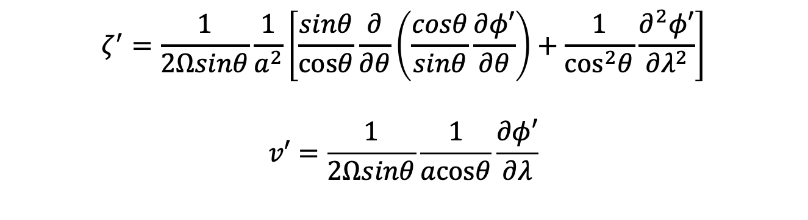
Eliminating $w^{′}$ in the governing equations, the potential vorticity equation can be written as:
$$\left(\frac{∂}{∂t}+\overline{ω}\frac{∂}{∂λ}\right)\left[ζ^{′}+\frac{1}{p}\frac{∂}{∂z}\left(\frac{p}{N^{2}}\frac{∂φ′}{∂z}\right)2Ωsinθ\right]+\frac{4Ω^{2}\sin^{2}θ}{N^{2}}acosθ\frac{∂\overline{ω}}{∂z}\left(\frac{∂v_{g}}{∂z}−\frac{∂v′}{∂z}\right)+\frac{∂\overline{q}}{a∂θ}v^{′}=0 (3)$$
Unknown variables: $ζ^{′}$, $φ′$, $v′$, perturbations associated with waves
Knowns ()$:associated with$ mean state (background winds)
$$ζ^{′}=\frac{1}{2Ωsinθ}\frac{1}{a^{2}}\left[\frac{sinθ}{cosθ}\frac{∂}{∂θ}\left(\frac{cosθ}{sinθ}\frac{∂φ′}{∂θ}\right)+\frac{1}{\cos^{2}θ}\frac{∂^{2}φ′}{∂λ^{2}}\right]$$
$$v′=\frac{1}{2Ωsinθ}\frac{1}{acosθ}\frac{∂φ′}{∂λ}$$

Slide 6
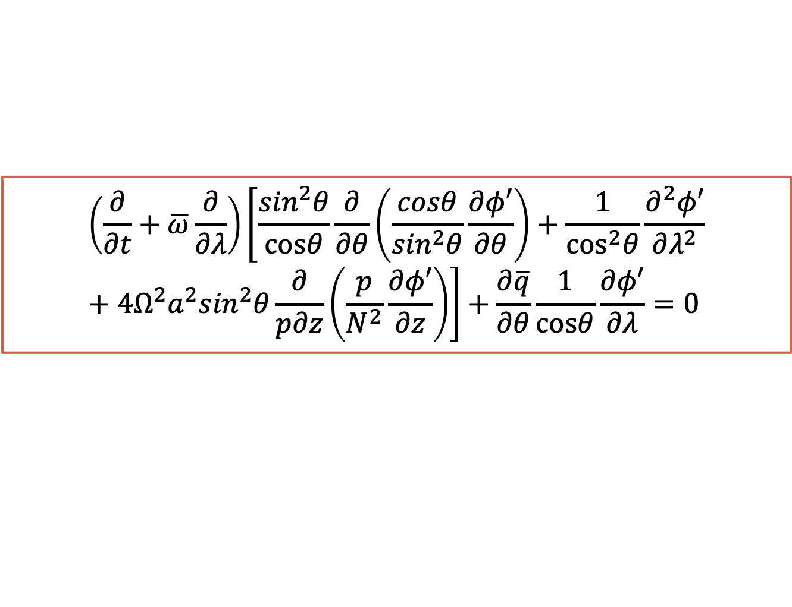
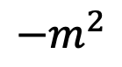
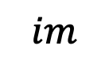
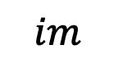
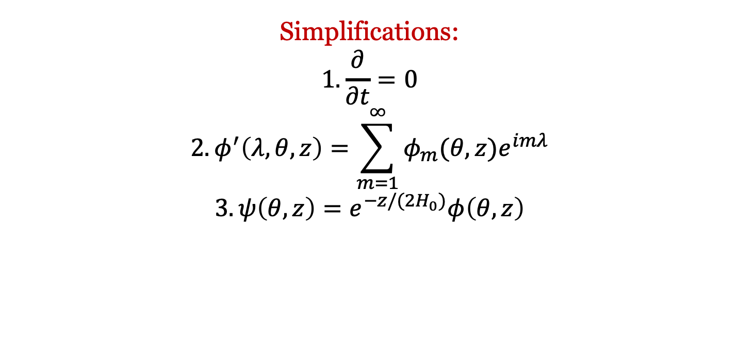
Applying the QG assumption, leading to a single equation ($φ′$):
$$\left(\frac{∂}{∂t}+\overline{ω}\frac{∂}{∂λ}\right)\left[\frac{\sin^{2}θ}{cosθ}\frac{∂}{∂θ}\left(\frac{cosθ}{\sin^{2}θ}\frac{∂φ′}{∂θ}\right)+\frac{1}{\cos^{2}θ}\frac{∂^{2}φ′}{∂λ^{2}}+4Ω^{2}a^{2}\sin^{2}θ\frac{∂}{p∂z}\left(\frac{p}{N^{2}}\frac{∂φ′}{∂z}\right)\right]+\frac{∂\overline{q}}{∂θ}\frac{1}{cosθ}\frac{∂φ′}{∂λ}=0$$
$$im$$
$$im$$
$$−m^{2}$$
Simplifications:
$$1. \frac{∂}{∂t}=0$$
$${2. φ}^{′}\left(λ,θ,z\right)=\sum_{m=1}^{∞}{φ_{m}(θ,z)e^{imλ}}$$
$$3. ψ\left(θ,z\right)=e^{−z/(2H_{0})}φ\left(θ,z\right)$$

Slide 7
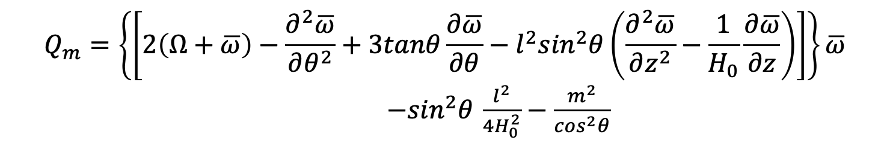
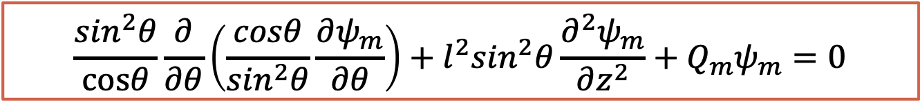
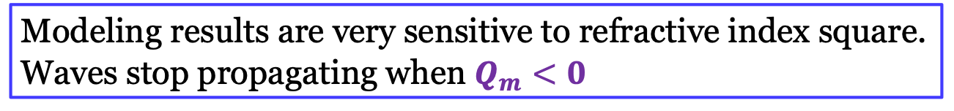
Numerical scheme is based on:
$$\frac{\sin^{2}θ}{cosθ}\frac{∂}{∂θ}\left(\frac{cosθ}{\sin^{2}θ}\frac{∂ψ_{m}}{∂θ}\right)+l^{2}\sin^{2}θ\frac{∂^{2}ψ_{m}}{∂z^{2}}+Q_{m}ψ_{m}=0$$
$$Q_{m}=\left\{\left[2\left(Ω+\overline{ω}\right)−\frac{∂^{2}\overline{ω}}{∂θ^{2}}+3tanθ\frac{∂\overline{ω}}{∂θ}−l^{2}\sin^{2}θ\left(\frac{∂^{2}\overline{ω}}{∂z^{2}}−\frac{1}{H_{0}}\frac{∂\overline{ω}}{∂z}\right)\right]\right\}\overline{ω}$$
$−\sin^{2}θ$ $\frac{l^{2}}{4H_{0}^{2}}−\frac{m^{2}}{\cos^{2}θ}$
refractive index square, determined by background atmospheric status such as wind and temperature.
Modeling results are very sensitive to refractive index square. Waves stop propagating when $Q_{m}<0$

Slide 8
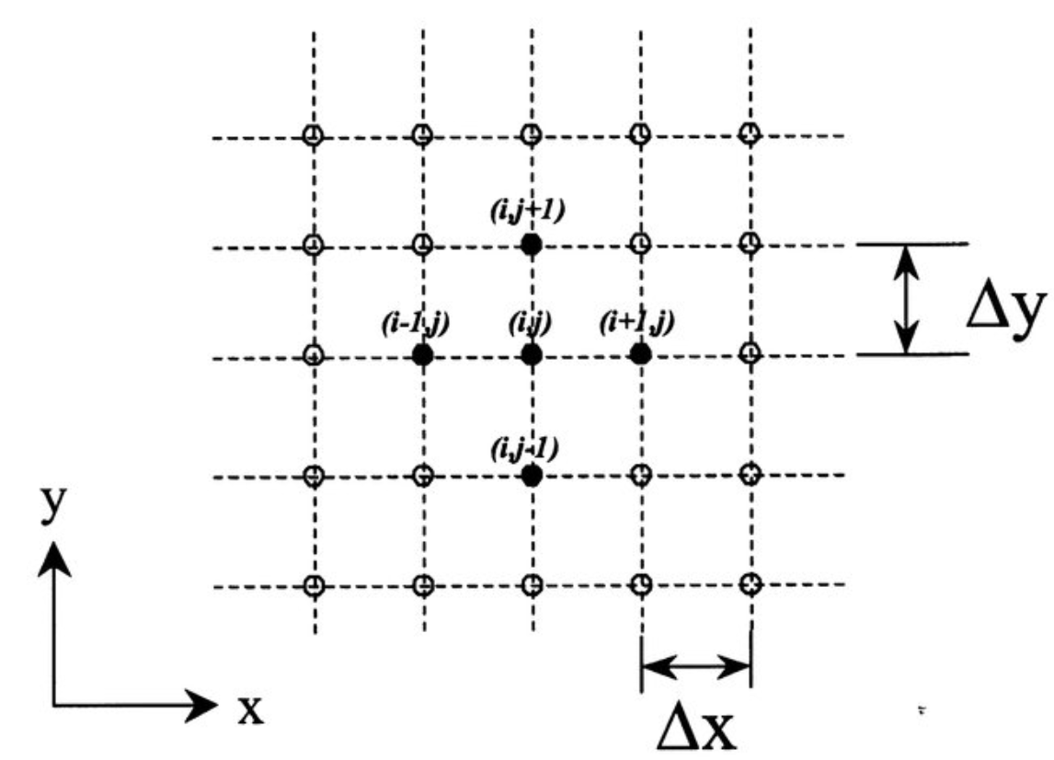
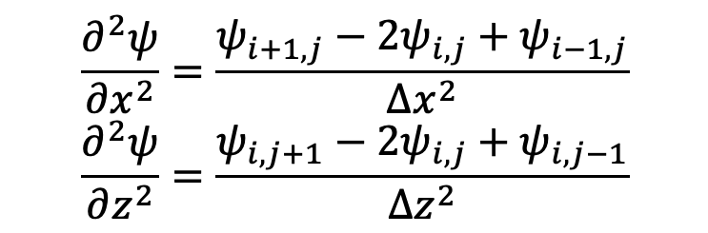
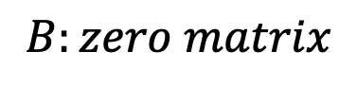
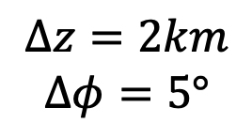
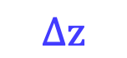
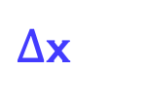
Numerical Scheme
$$\frac{∂^{2}ψ}{∂x^{2}}=\frac{ψ_{i+1,j}−2ψ_{i,j}+ψ_{i−1,j}}{∆x^{2}}$$
$$\frac{∂^{2}ψ}{∂z^{2}}=\frac{ψ_{i,j+1}−2ψ_{i,j}+ψ_{i,j−1}}{∆z^{2}}$$
$$∆z=2km$$
$$∆φ=5°$$
Space Difference second order differential equation
Matrix Method
$$∆z$$
z
$∆$x
x
$$B:zero matrix$$

Slide 9
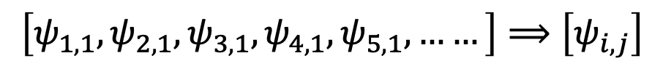
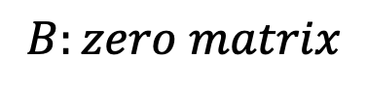
Numerical Scheme
Matrix Method
$$B:zero matrix$$
Use lower boundary condition to determine the internal field:
$$\left[ψ_{1,1},ψ_{2,1},ψ_{3,1},ψ_{4,1},ψ_{5,1},……\right]⟹\left[ψ_{i,j}\right]$$

Slide 10
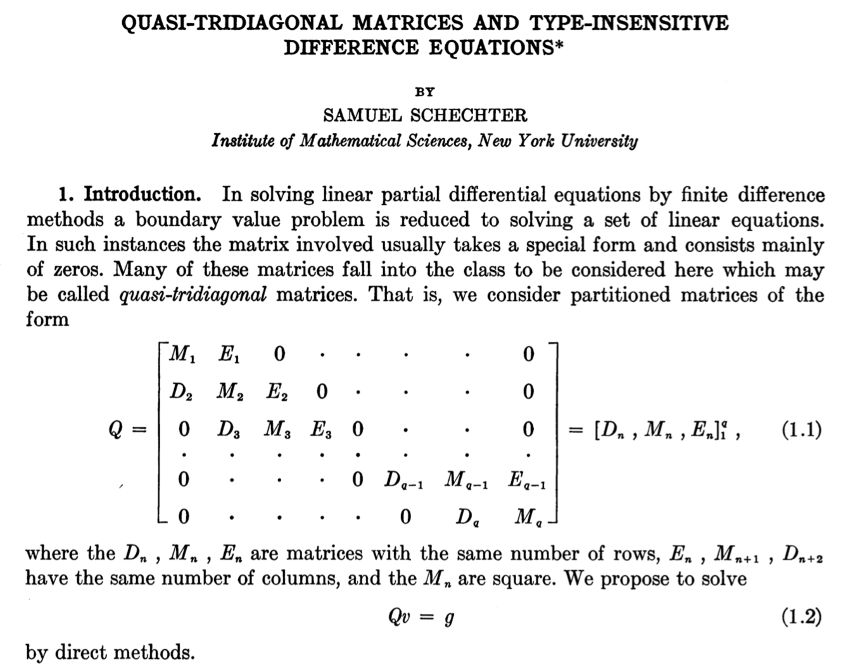
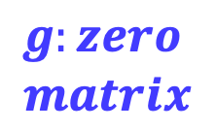
Solve Quasi-Tridiagonal Matrices
No external Forcing: forced by lower boundary
Sparse matrix (a lot of zeros)
$$g:zero$$
$$matrix$$

Slide 11
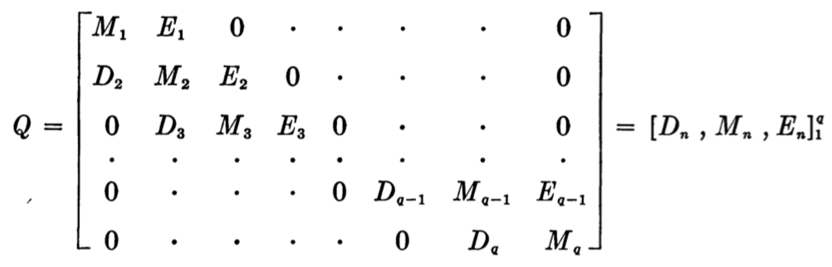
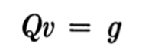
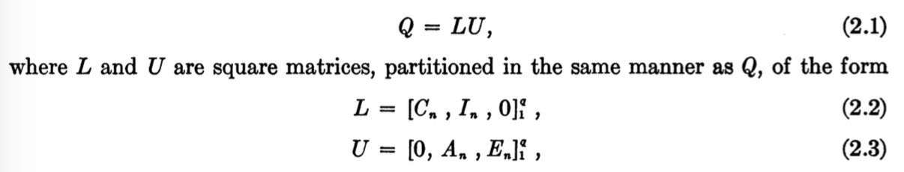
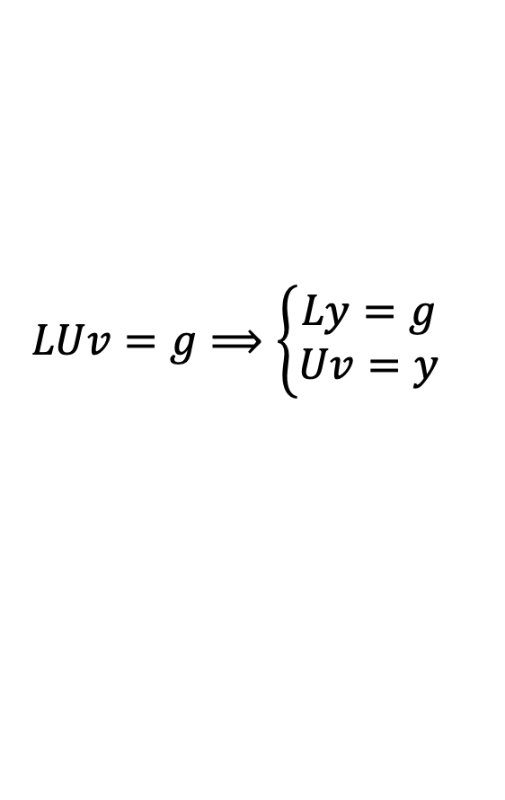
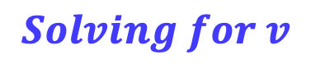
Forward/backward iteration
$$Solving for v$$
LU Method: decompose the original matrix to one lower triangular matrix and one upper triangular matrix
$$LUv=g⟹\left\{\begin{aligned}Ly=g \\ Uv=y\end{aligned}\right.$$
Equation converts to:

Slide 12
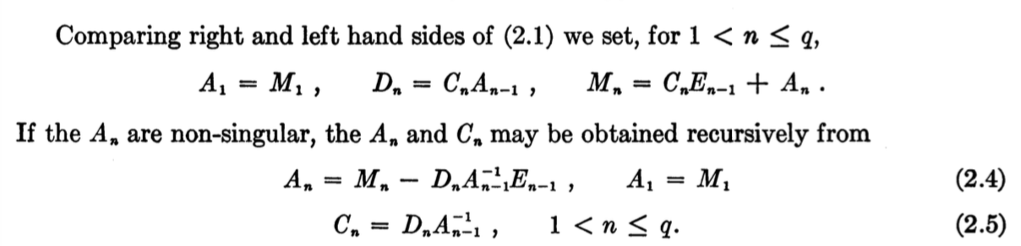
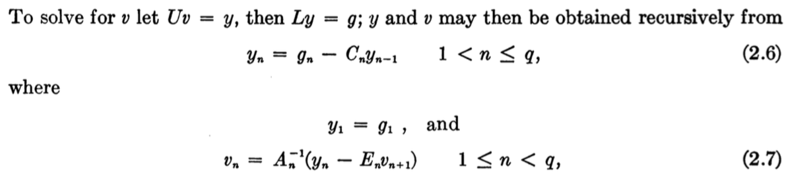
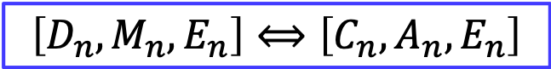
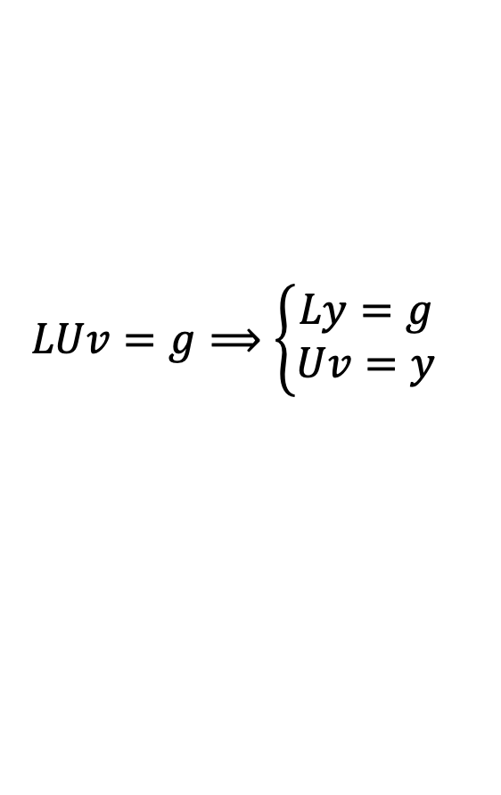
Coefficient Matrix Correlation
$$\left[D_{n},M_{n},E_{n}\right]⟺\left[C_{n},A_{n},E_{n}\right]$$
Solution
$$LUv=g⟹\left\{\begin{aligned}Ly=g \\ Uv=y\end{aligned}\right.$$
Solve y from g
then solve v from y

Slide 13
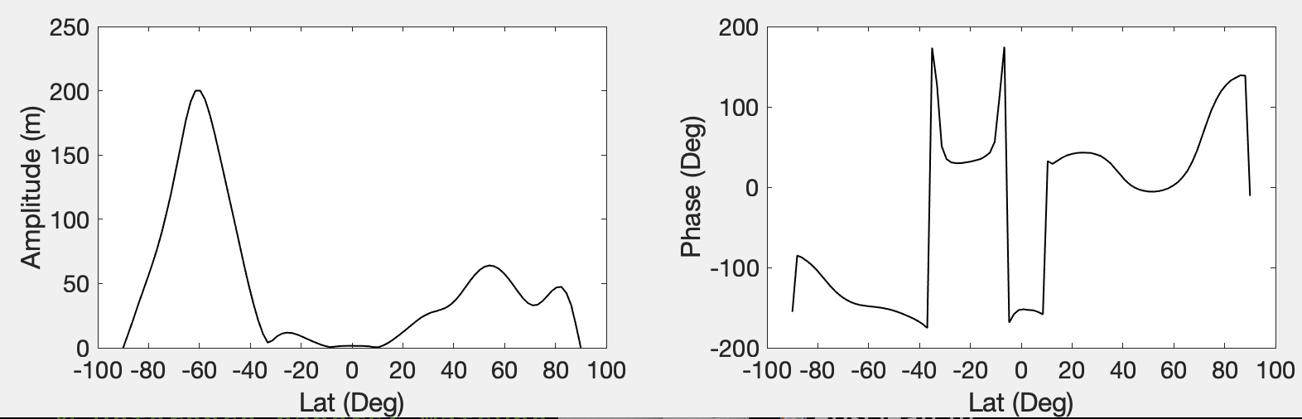
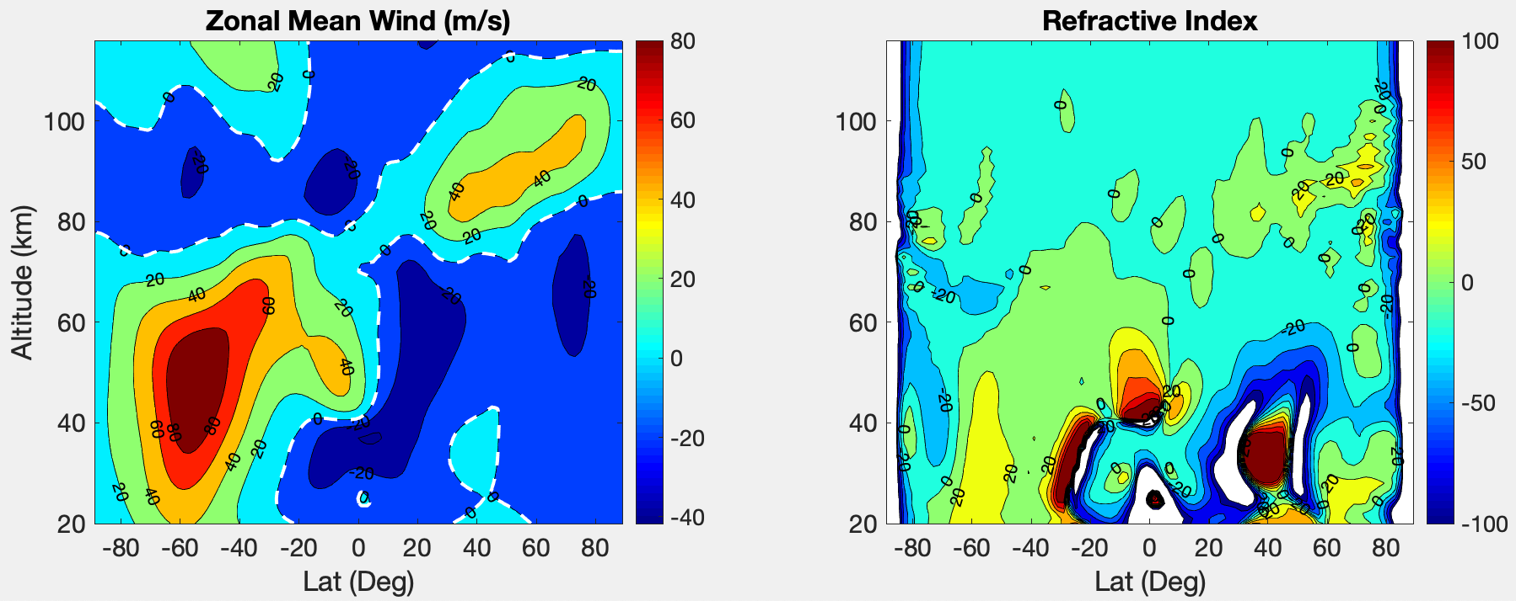
Lower Boundary Condition
Background Wind Condition

Slide 14
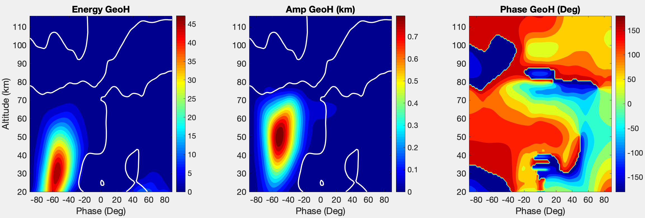
Lower Boundary Condition
Wave Amplitude and Phase

Slide 15
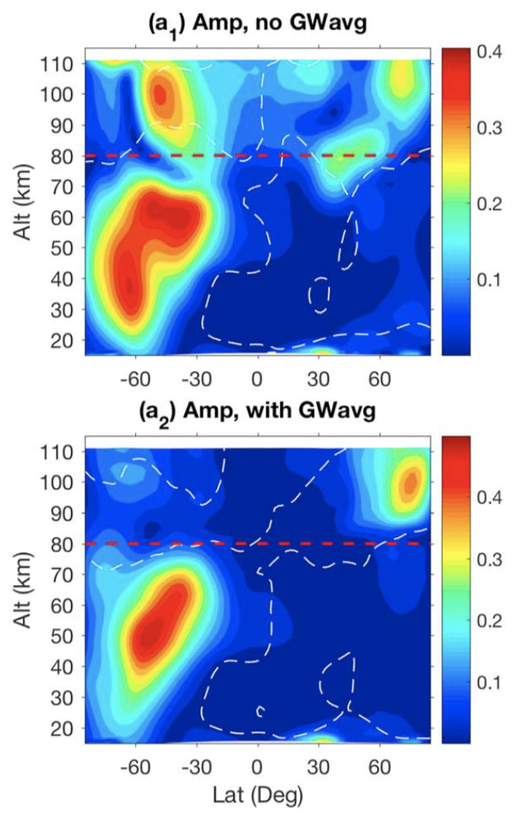
From governing equations without forcing and gravity wave effects, internal fields of SPWs are fully determined by lbc and mean background winds.
SPWs can’t pass zero-wind lines and propagate into the upper atmosphere (being filtered): different from observations.
Lu et al., 2018
Stratospheric SPWs modulate GWs, which propagate upward and bring SPW signatures to upper atmosphere where they break.

Slide 16
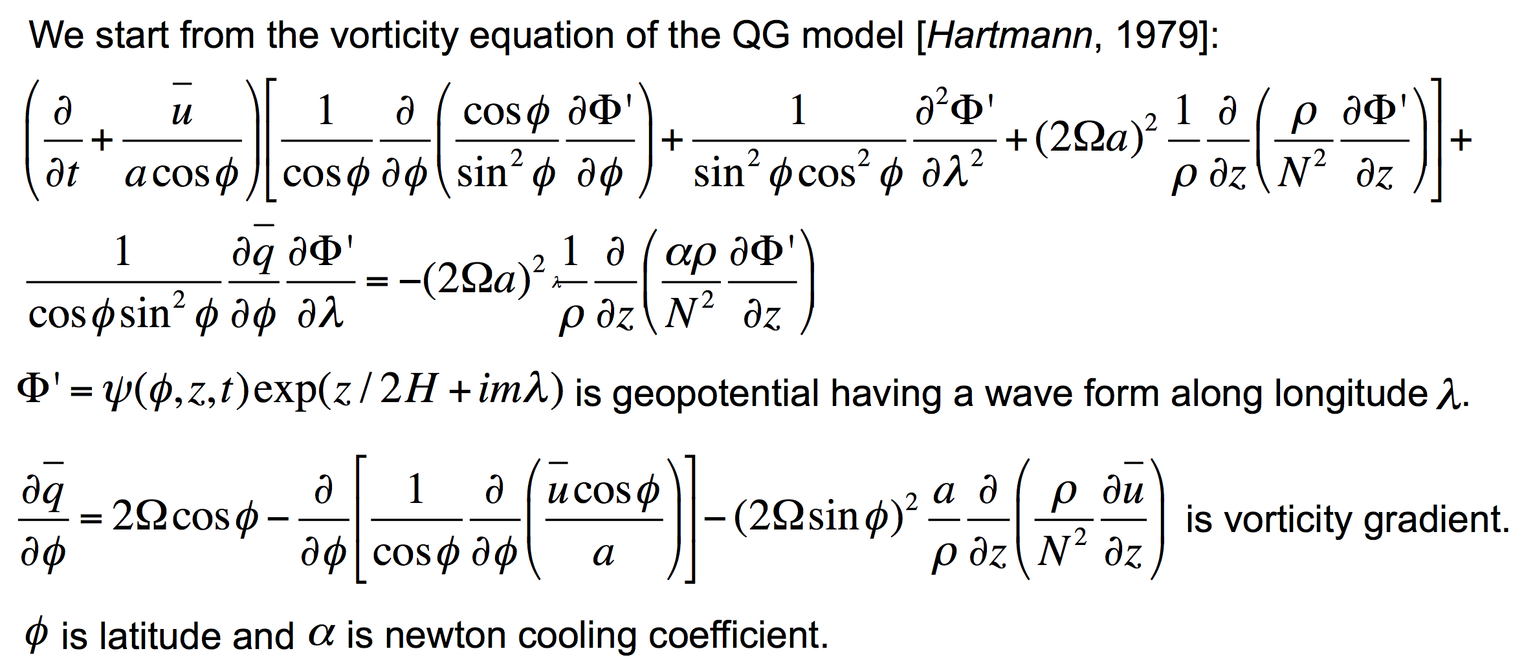
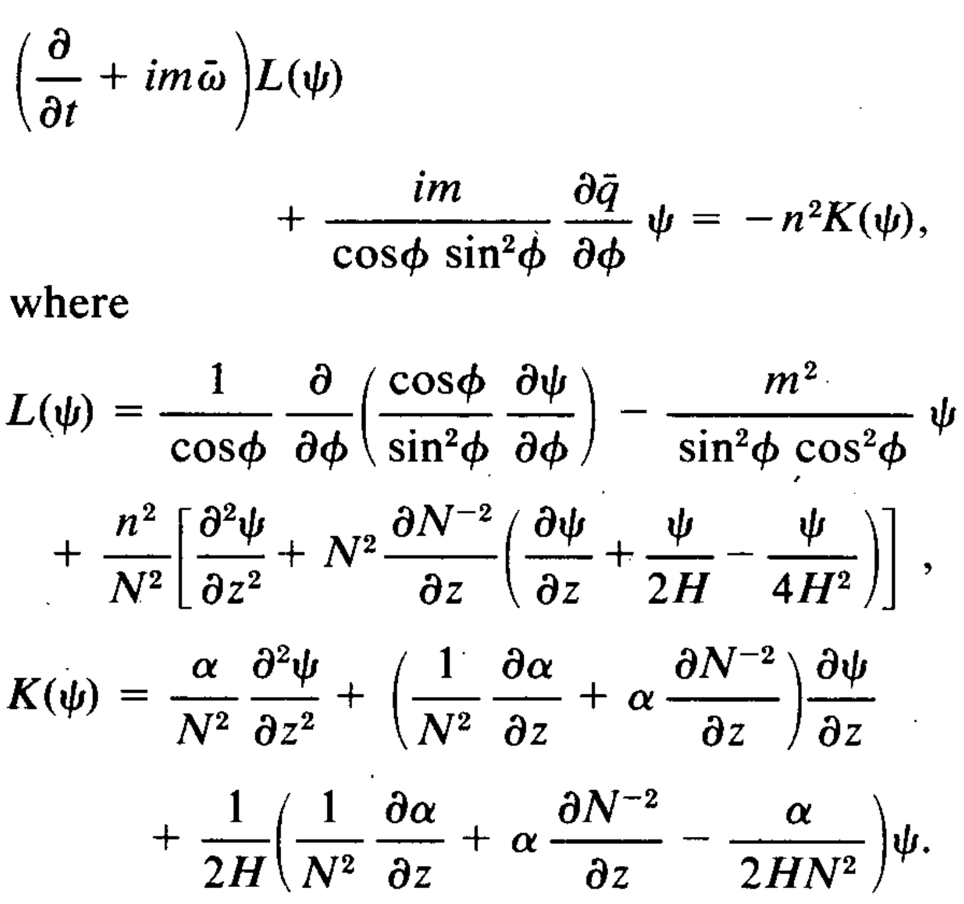
Governing Equations For TPWs
Because it is a wave form along longitude, it becomes a 3-D problem as a function of latitude, altitude and time.

Slide 17
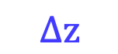
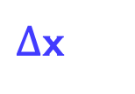
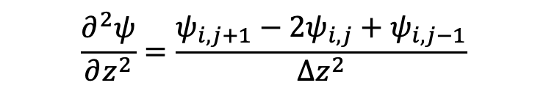
Numerical Scheme
Forward Time
Space Difference second order differential equation
$$\frac{∂^{2}ψ}{∂z^{2}}=\frac{ψ_{i,j+1}−2ψ_{i,j}+ψ_{i,j−1}}{∆z^{2}}$$
Matrix Method
z
$$∆z$$
$∆$x
x

Slide 18
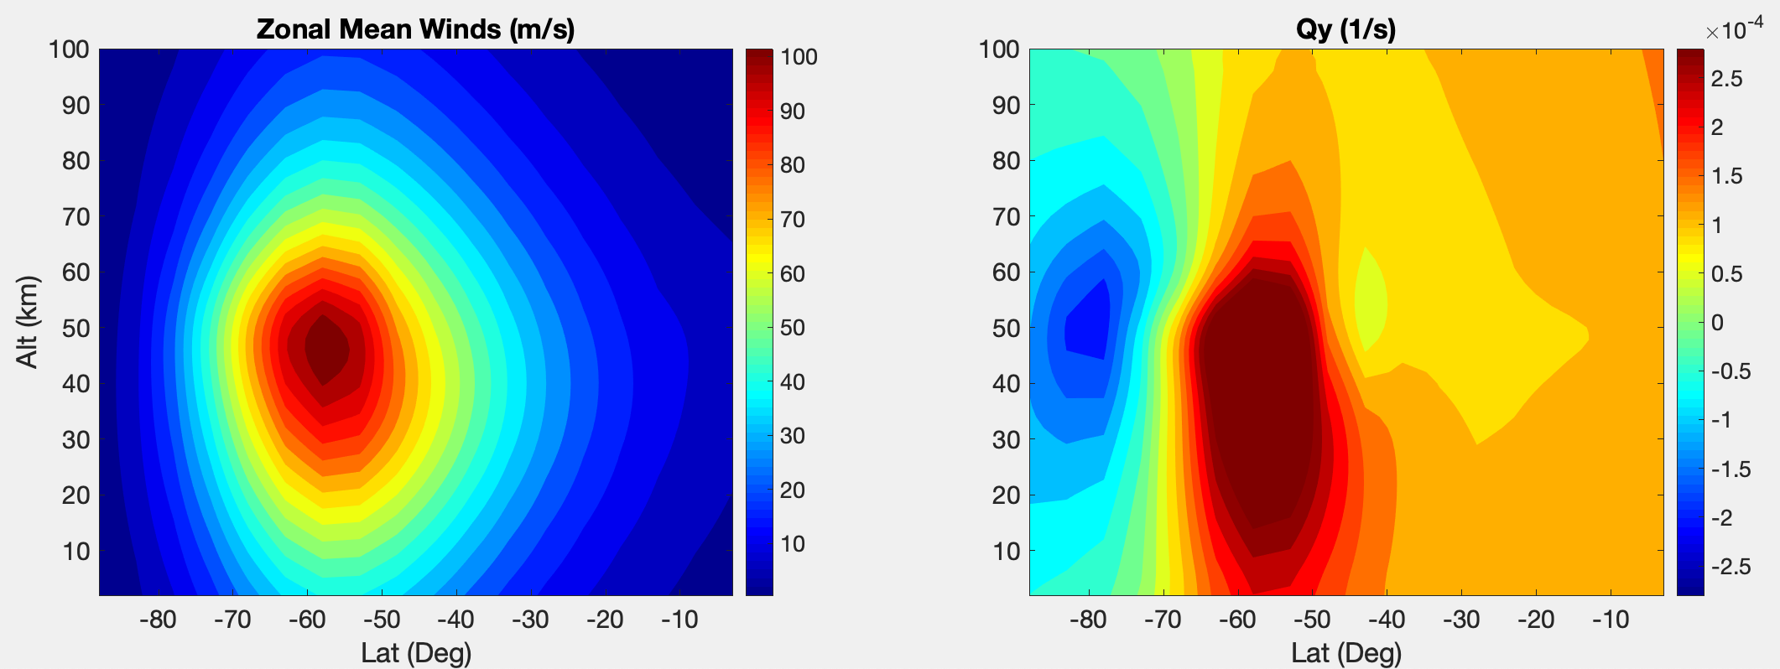
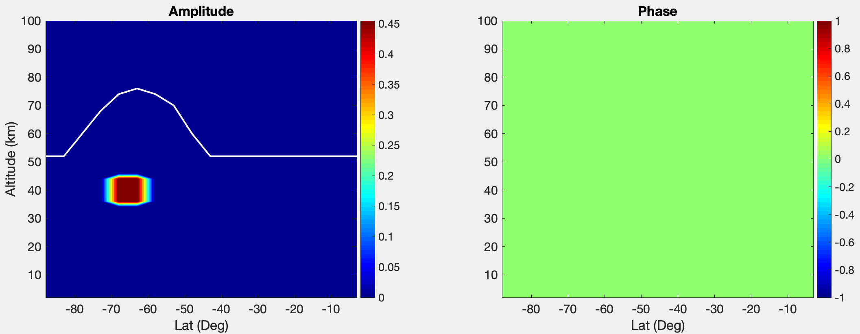
Initial Condition Problem
Background
Wind
&Instability
Initial
Condition
Random
disturbances

Slide 19
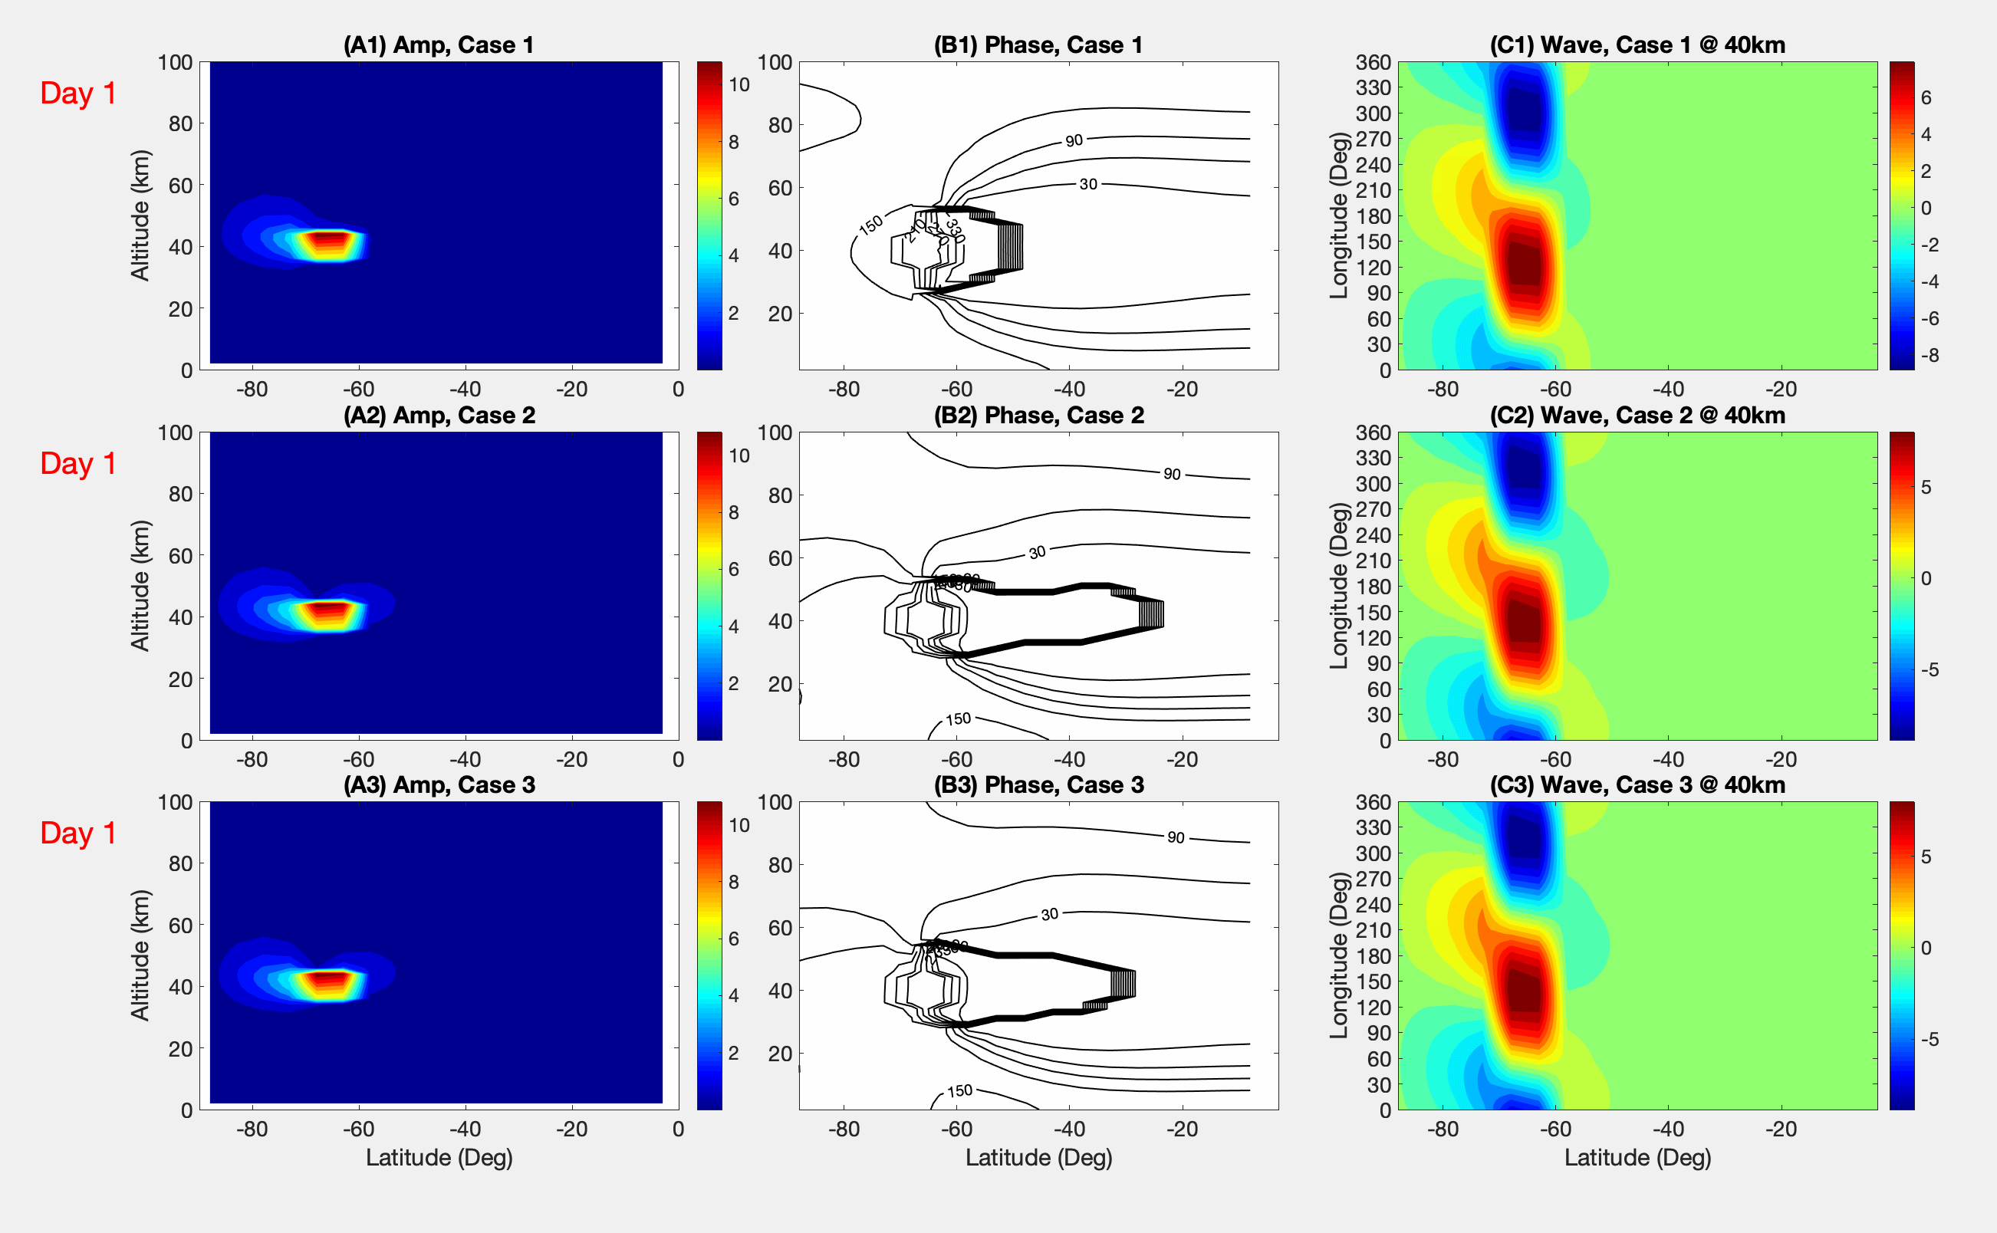
Initial Condition Problem

Slide 20
QBO Impacts on TPWs
Double cell = QBOe-QBOw
Lu et al., 2019

Slide 21
QBO Impacts on TPWs
QBOe:
Stronger Polar Vortex
Great instability
Larger growth rate
Shorter wave period
Larger amplitudes of planetary waves
Lu et al., 2019

Slide 22
PHYS 4200/6200
Course Evaluation

